Slide 1
Optimizing Travel Efﬁciency: A Comprehensive Overview of the Online Bus Reservation System

Slide 2
TEAM LEADER
MBA
Bhumika
CODING
ISE & CSE
Supriya
Pravalika
Harshitha
Keerthi Soniya
T E A M
D E T A I L S
DOCUMENTATION
CIVIL
H Rakshankitha
Shashank V
Hemanth

Slide 3
TECHNICAL
AIML
Mark
PRESENTATION
Sehaj kaur Behl
CSE
T E A M
D E T A I L S

Slide 4
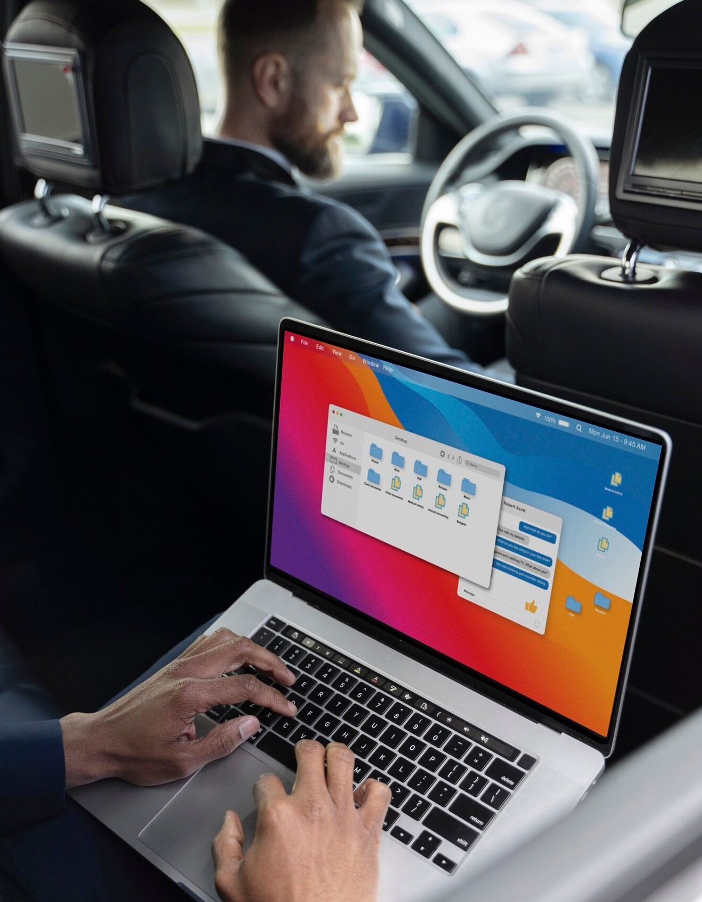
Introduction to Bus Reservation Systems
In today's fast-paced world, optimizing travel efﬁciency is crucial. Online Bus Reservation Systems simplify the booking process, enhancing user experience and streamlining operations. This presentation will explore the components, beneﬁts, and best practices of these systems for effective travel management.

Slide 5
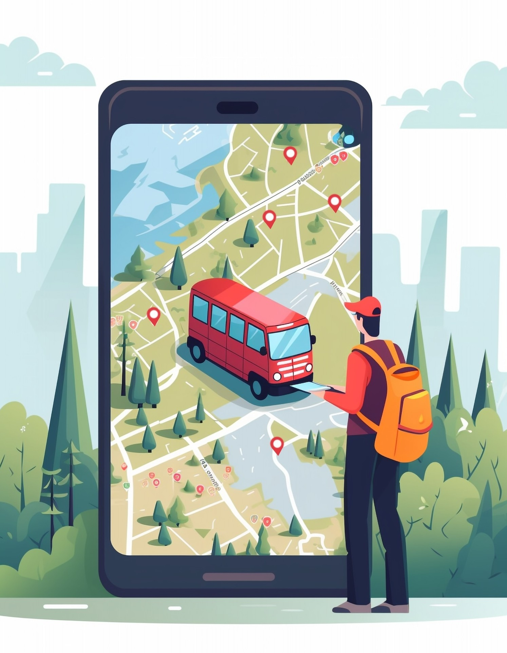
Key Components of the System
An effective Online Bus Reservation System includes several key components: user interface, database management, and payment processing. These elements work together to ensure a seamless experience for customers, from searching for routes to completing transactions securely.

Slide 6

Beneﬁts of Online Reservations
Utilizing an Online Bus Reservation System offers numerous beneﬁts, such as 24/7 accessibility, reduced operational costs, and improved customer satisfaction. By providing real-time information and easy booking options, businesses can enhance their service quality and attract more travelers.

Slide 7

Challenges in Implementation
Implementing an Online Bus Reservation System comes with challenges, including technical issues, user adoption, and data security concerns. Addressing these challenges requires strategic planning and robust support systems to ensure a smooth transition and ongoing operation.

Slide 8

Best Practices for Optimization
To optimize an Online Bus Reservation System, consider best practices such as user-centered design, regular updates, and effective marketing strategies. These practices can signiﬁcantly enhance system performance, ensuring users have a positive and efﬁcient booking experience.

Slide 9
DEMO OF THE SYSTEM

Slide 10

Conclusion and Future Outlook
In conclusion, optimizing travel efﬁciency through an Online Bus Reservation System is essential for modern transportation. As technology advances, these systems will continue to evolve, offering even greater convenience and efﬁciency for travelers in the future.

Slide 11
Thank You!

